Slide 1
Lecture 14
The Structure of the Urban Systems and the Laws of Geography
14.2 Demographic Dynamics and the Structure of Urban Systems
IUS 8.2
©Luís M. A. Bettencourt 2024
Notes:
So where do the laws of geography come from? As you saw in the last module, most of them are about demography (dynamics of the numbers of people), such as Zipf’s law, or laws about flows (gravity) and growth (Gibrat). So a good place to start is demography. Note that predictability is often found around conserved quantities: things that cannot appear or disappear willy nilly and people are in this sense a conserved quantity:

Slide 2
Fundamental Dynamics of Cities
Start with demography
The population change of a city can be decomposed into:
Births
Deaths
Migration between cities
from rural areas
from abroad
vital rates
Notes:
With any conserved quantity we need only keep track of creation, disappearance and movement. For populations these are simply births, deaths and migration. We need to characterize these events over subpopulations, so naturally we will concentrate on cities. For migration we often do not know every small place and we may not know movements to/from abroad at the same precision.

Slide 3
Population Growth Accounting
$$J_{ij}$$
$$D_{i}$$
# people migrating from i to j
Deaths
over a period of time
e.g. year
emigration
foreign+rural
migration
city j
city i
$$M_{i}$$
$$N_{i}$$
$$N_{i}$$
$$N_{j}$$
$$B_{i}$$
higher income nations
tend to see net inflows
Births
immigration
$$J_{ji}$$
# people migrating from j to i
$$N_{i}(t+1)=N_{i}(t)+B_{i}-D_{i}+M_{i}+\overset{N_{c}}{\underset{j}{∑}}(J_{ij}-J_{ij})$$
sum over cities
Notes:
But with these caveats we can write some equations, which are nothing more and nothing less than the conservation of people via these processes. So in each city, its number of people are the number of people in the previous time step plus those born minus those dead, plus those that migrated in and minus those that migrated out. That’s all there is to it …

Slide 4
Population Growth Accounting
Introduce rates (per capita):
$$b_{i}=\frac{B_{i}}{N_{i}}$$
birth rate
$$v_{i}=b_{i}-d_{i}+m_{i}^{F+R}$$
$$d_{i}=\frac{D_{i}}{N_{i}}$$
death rate
foreign + rural
“vital” rate
$$m_{i}^{F+R}=\frac{M_{i}}{N_{i}}$$
foreign and rural migration
rate
$$N_{i}(t+1)=(1+v_{i})N_{i}(t)+\overset{N_{c}}{\underset{j}{∑}}(J_{ij}-J_{ij})$$
Simpler!
what to do w/ migration flows?
Notes:
To make progress, we now need to write the same equation in a more interesting form, we start by considering birth and death rates (numbers of events per person), these numbers are small (less than 1% per year in the US population) and quite stable, meaning that they change slowly in time. We will also deal with rate of foreign and rural migration in the same way because our data only tells us about them in bulk (you could otherwise do what we will do next for the intercity rates)…

Slide 5
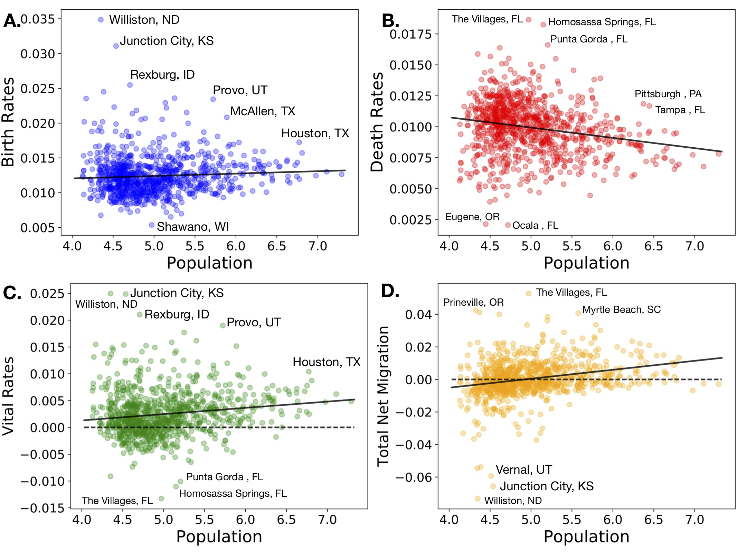
Notes:
OK, and just as a reality check with data, here are the birth dates, death rates, vital rates and migration rates for cities. Some interesting features here. Birth rates increase a little with city size and death rates decrease: this maybe because in larger cities population tend to be a bit younger. Some strong outliers for births are places with specie characters, some quite religious. Places with large death rates tend to be retirement towns, especially in FL. You can find more interesting stories in this sort of data, if you look…

Slide 6
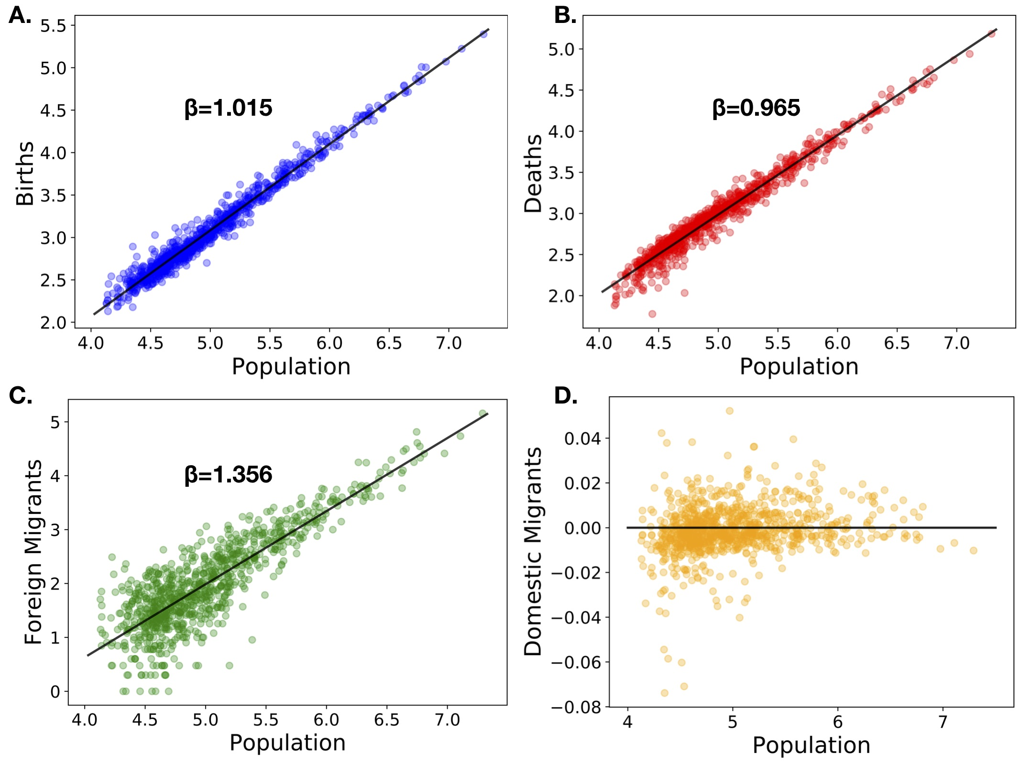
larger cities have
somewhat younger
populations
people move to
smaller cities
late in life
LA
Chicago
NYC
Foreigners prefer
to live in the
largest cities
Many large
cities are loosing
US born population
Notes:
And just for completeness, here are the scaling relations for some of the same quantities. Note how Foreign in migration is strongly focused on larger cities, and also how the 3 largest US cities have a deficit of internal migration.

Slide 7
Matrix Models
Trick:
$$N(t+1)=A(t)N(t)$$
try to write population change as
Then solution is simple:
$$N(t+1)=A(t)A(t-1)A(t-2)...A(1)N(0)$$
If A does not depend on time, it is VERY simple:
$$N(t+1)=A^{t}N(0)$$
what is ?
what is ?
$$A$$
$$A^{t}$$
Notes:
So, how do we use these equations to predict the future? The solution depends on the characteristics of the parameters, the vital and migration rates. The simplest situation is when these are constant in time. Then, there is a canonical way to solve these equation for the joint evolution of the urban system (these are known as matrix population models). We can place the rates in the matrix A, and the time evolution then is the iterated dynamics as shown, which is the matrix multiplied t (time intervals) times.

Slide 8
Matrix Models
We can write the migration current as
$$J_{ij}=m_{ij}N_{i}$$
probability per person that
someone in city i choses to move to city j
$$N_{i}(t+1)=\overset{N_{c}}{\underset{i=1}{∑}}A_{ij}(t)N_{j}(t)$$
if these are independent of time
then A is fixed
$$A_{ij}=(1+v_{i}-m_{i}^{out})1_{ij}+m_{ji}$$
$$m_{i}^{out}=\overset{N_{c}}{\underset{j=1}{∑}}m_{ij}<1$$
is the probability per individual
to leave city i
Notes:
Let’s look at the original equations to see what goes into the A matrix. In order to do this we need to express the intercity migration flows in terms of rates as well. Again, for now we are assuming that these rates do not change in time.

Slide 9
Matrix Solution
The solution to
$$N(t+1)=A(t)N(t)$$
follows from the eigenvalues of A:
$$Ae_{k}=λ_{k}e_{k},k=0,1,...,N_{c}-1$$
$$N(t)=\overset{N_{c}-1}{\underset{k=0}{∑}}λ_{k}^{t}c_{k}e_{k}$$
$$N(0)=\overset{N_{c}}{\underset{j=1}{∑}}c_{k}e_{k}$$
The full solution is:
with the such that:
$$c_{k}$$
It all depends now on the eigenvalues and eigenvectors
Strongly Connected Graphs
Notes:
Under these conditions, the solution of the dynamical equation is written in terms of an eigenvalue/vector problem (look up your linear algebra if necessary). The solution is written in terms of the temporal power of the eigenvalues times the corresponding eigenvector projected on the initial conditions.

Slide 10
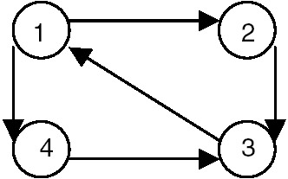
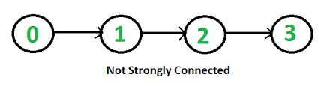
Strongly Connected Graphs
strongly connected
any node can be reached from any other node
NOT strongly connected
some nodes cannot be reached from other nodes
Migration Flows form a Strongly Connected Graph
any city can be reached from any other following migration flows
Notes:
What is interesting now is that there is a lot known about these eigenvalues. For a strongly connected graph (the migration flows between cities, which are the nodes) has positive eigenvalues. Intuitively, this means that there is a lot of mixing between cities as populations go back and forth and that no city is just sending out people or just receiving people.

Slide 11
Strongly Connected Graphs
Perron-Frobenius Theorem
https://en.wikipedia.org/wiki/Perron–Frobenius_theorem
1) The largest eigenvalue
$$λ_{0}$$
is a positive real number
2) The corresponding eigenvector, , is made of all positive numbers:
PageRank
$$e_{0}$$
3) All other eigenvalues are smaller (real part)
So, the solution will look like
$$N(t)=λ_{0}^{t}\left(c_{0}e_{0}+{\left(\frac{λ_{1}}{λ_{0}}\right)}^{t}c_{1}e_{1}+{\left(\frac{λ_{2}}{λ_{0}}\right)}^{t}c_{2}e_{2}+…\right)→λ_{0}^{t}c_{0}e_{0}$$
Gibrat’s law
(not statistical)
$$e^{-\left(ln\frac{λ_{0}}{λ_{1}}\right)t}$$
$$e^{-\left(ln\frac{λ_{0}}{λ_{2}}\right)t}→0$$
,
Dominant mode: all cities grow at same rate
Same argument for economic flows
Notes:
Then there is a very famous theorem of linear algebra (Perron - Frobenius) that tells us that there is a dominant eigenvalue, and that the corresponding eigenvector has all positive numbers. Over time, this eigenvector becomes dominant, because it grows fastest, and the solution dimensionally reduces to it. The consequence is that all cities then grow with the same common growth rate (given by this eigenvalue): This is one way you can get Gibrat’s law, note that the growth rate is a collective property of the system of cities.

Slide 12
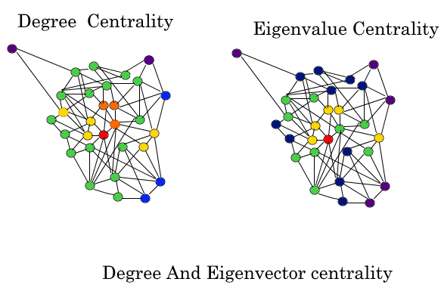
Power and Influence in Networks
Centrality
emphasizes nodes that have high degree
and
are connected to others of high degree
in recursive manner
A node with high eigenvalue centrality controls not only more other nodes
but also those who can control more and so on…
Notes:
This algorithm - of identifying the dominant eigenvalue/vector is also very famous structurally. Sociologists has discovered it as a means to identify power in a network, as the node that has the highest entry in the dominant eigenvector and so on…

Slide 13

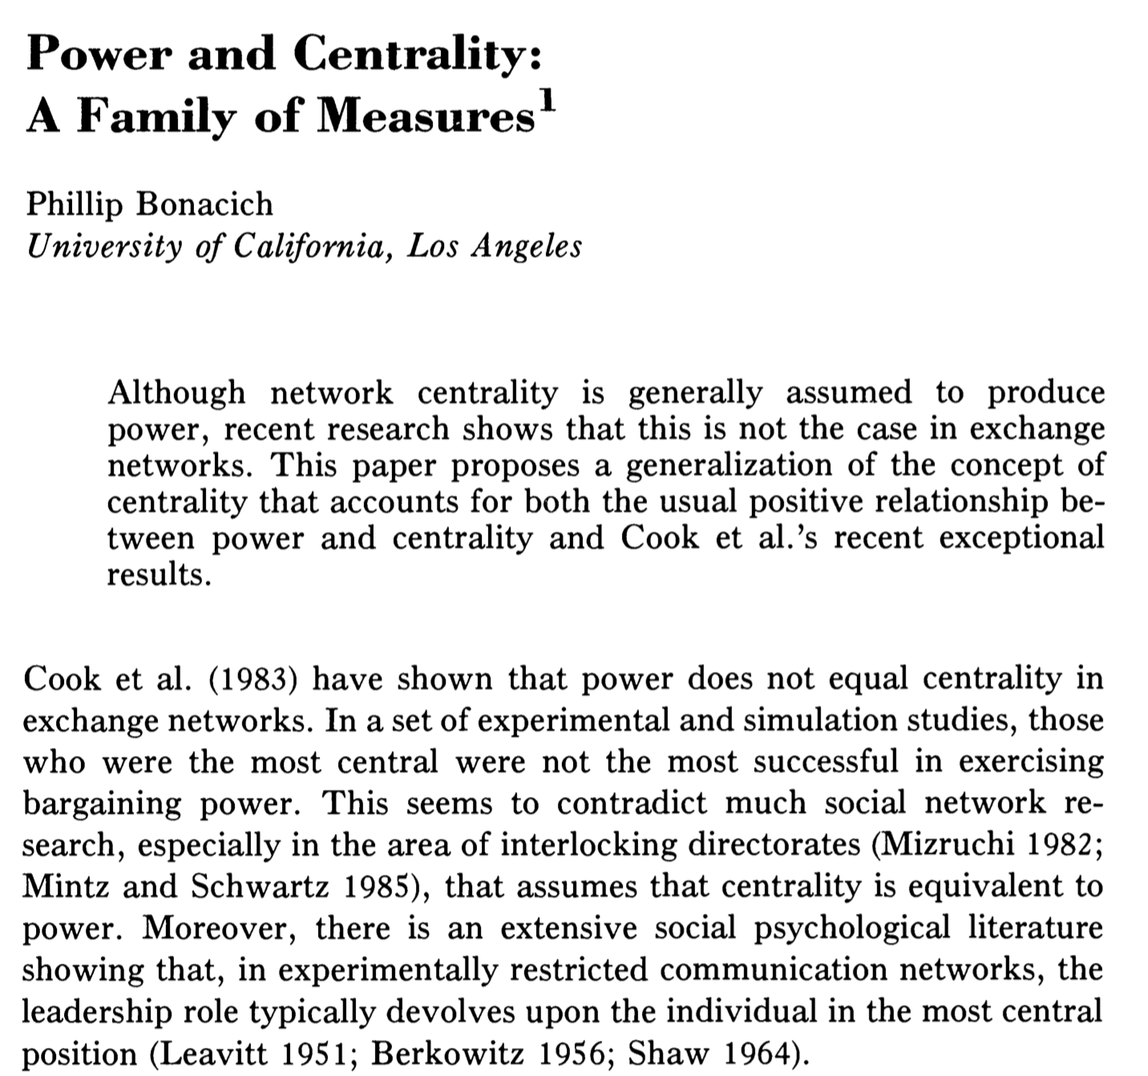
Power and Influence in Networks
1987
pioneered by sociologists and geographers
https://www.jstor.org/stable/2780000
Notes:
Here’s is a nice review from mathematical sociology… Geographers also had a similar (spatial) result, even earlier.

Slide 14

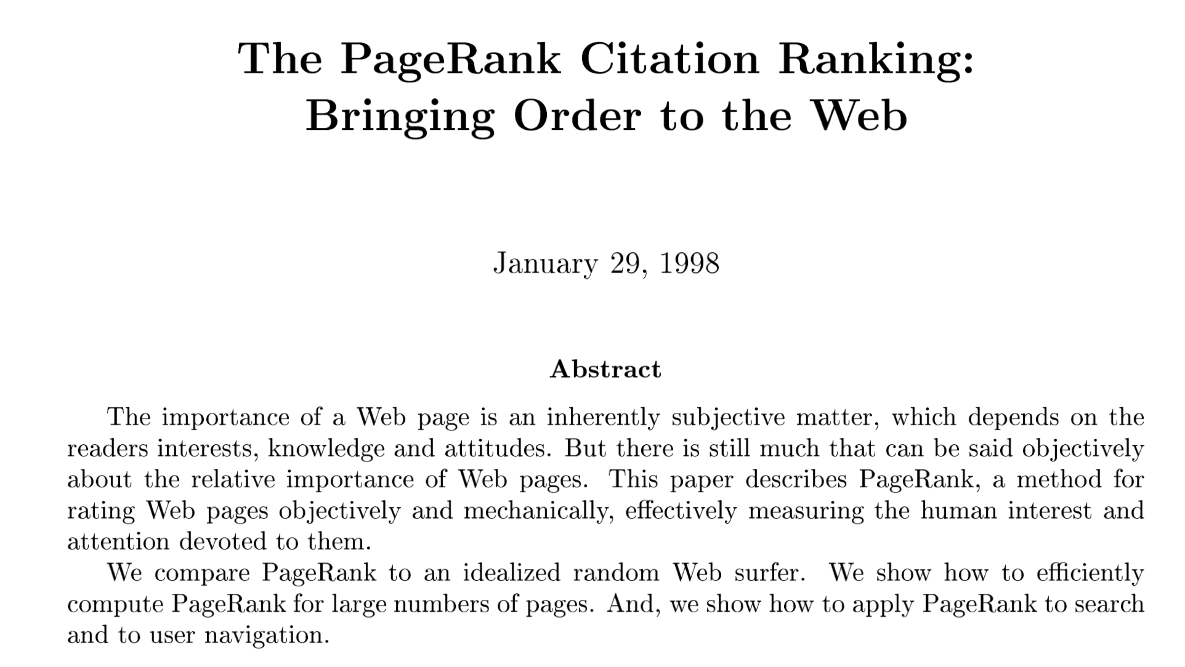
PageRank
Page and Brin
http://ilpubs.stanford.edu:8090/422/
Notes:
Of course this was rediscovered by the Google founders as the basis for ranking webpages and web search, and it was immediately a much better algorithm than what other companies were using. In my view Google owes a lot of money to sociologists and geographers …. Alas…

Slide 15

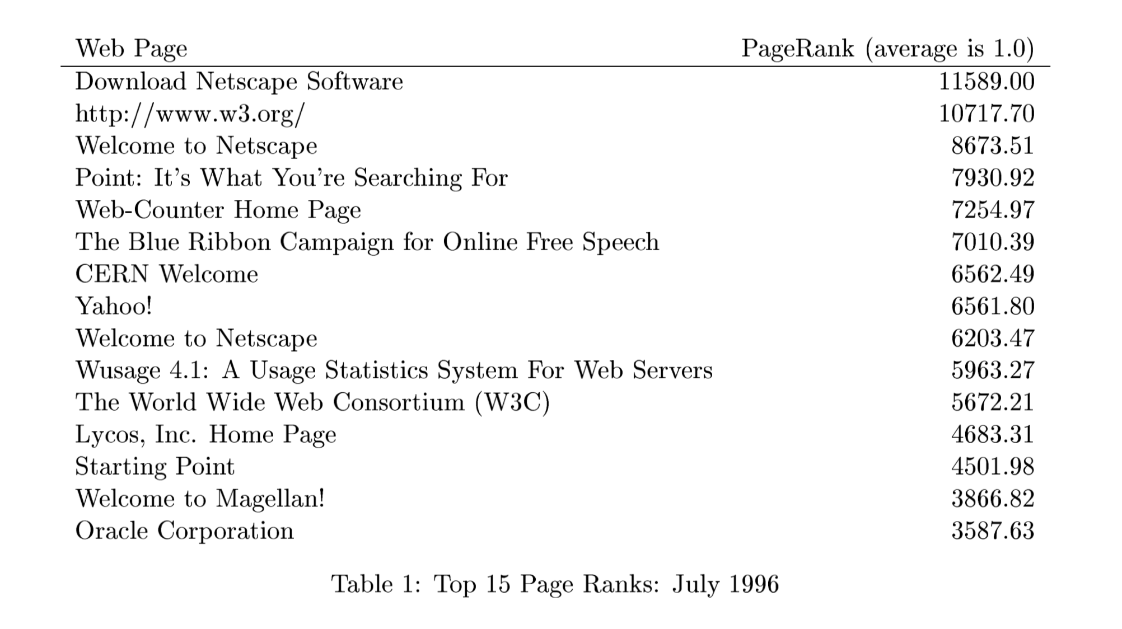
http://ilpubs.stanford.edu:8090/422/
Notes:
Just for fun, here was the rank (power) of various websites in PageRanks first algorithm.

Slide 16
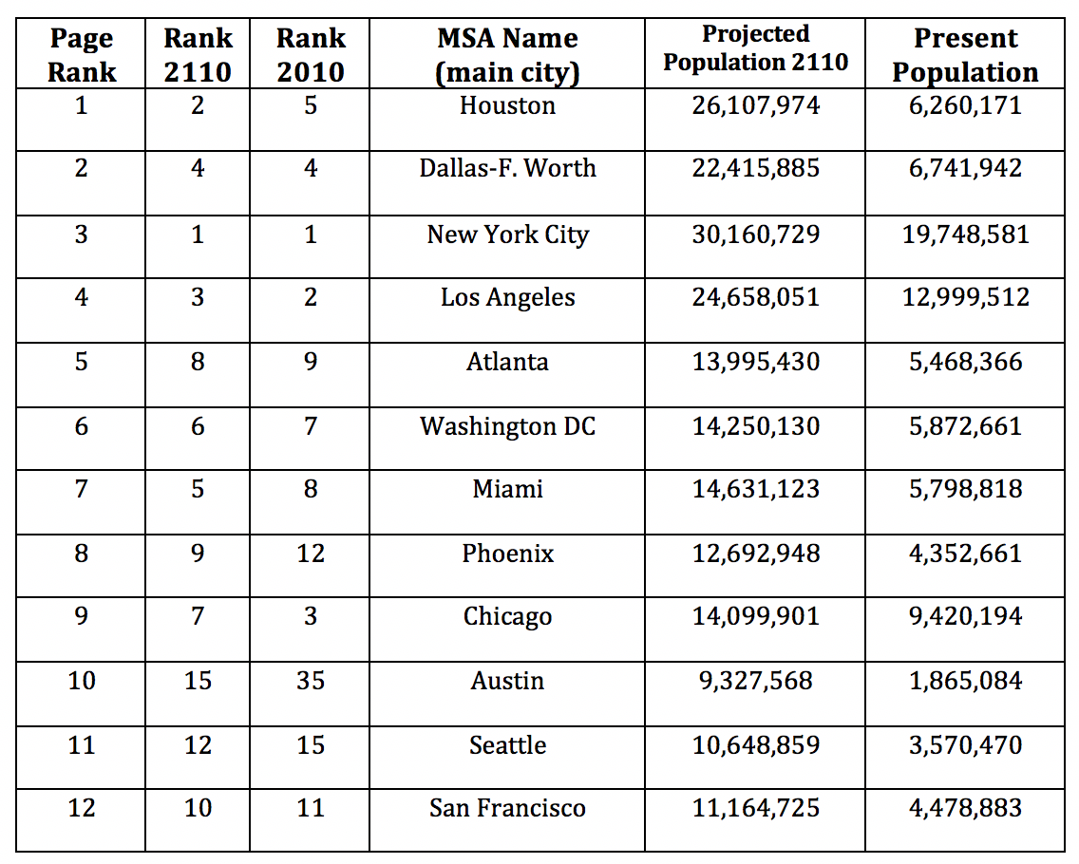
City Population Size Projections
migration from US Census 2010
largest city in US by 2210
Notes:
When we apply this to our system of cities, this is what we find (2010 data, now a bit old). The highest page rank, (most “powerful”) city is … Houston. In general the cities of TX and some in the South and SW at this point do well because they are attracting people. While some cities in the MidWest and East (Chicago, Philly) are predicted to become relatively smaller. This, however takes a long time, a couple of centuries…

Slide 17
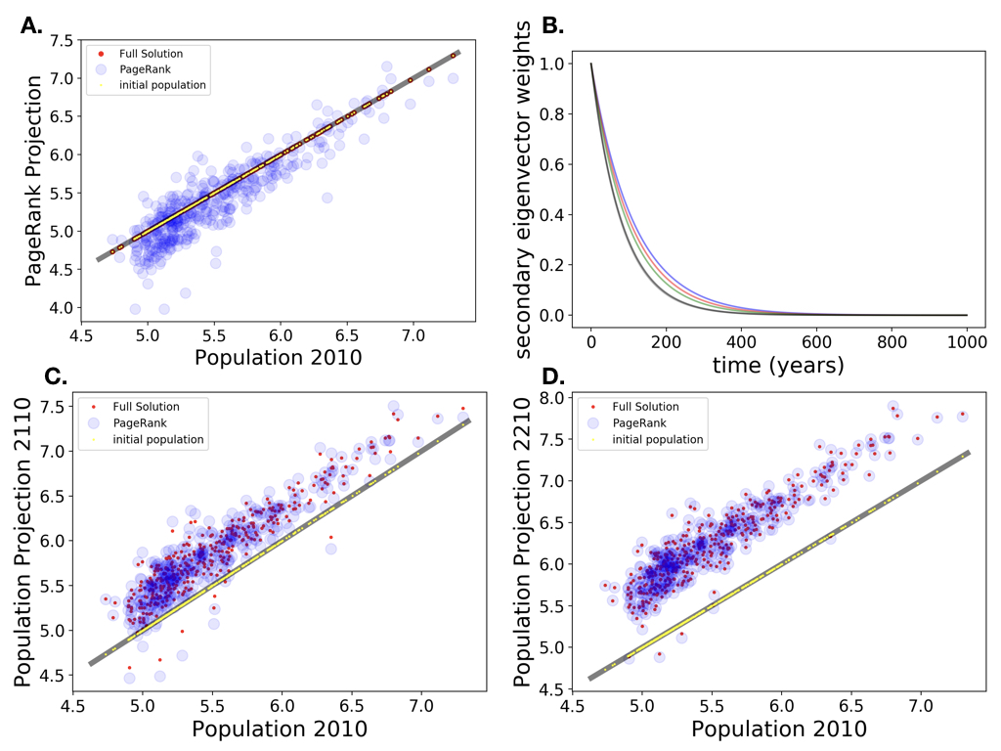
144 years (census 2010)
decay of ratio of eigenvalues
Initial Population
Population in 2110
Population in 2210
near perfect agreement with PageRank
Notes:
Here’s what the evolution in time looks like: it is very slow with a characteristic time of 144 years being the decay rate, the ratio of the two largest eigenvalues. This is partly because the US is changing slowly compared to the past, with small vital and migration rates than in the past. Nevertheless, you could imagine a fairly different urban system, with Houston taking the crown from NYC in a couple of centuries, if things stay the same (Houston would have to deal with climate change for example)…

Slide 18
This may well describe what happens if the environment doesn’t change.
But this is not Zipf’s law for the size distribution of cities:
What are we missing? What could get us there? Or closer?
write migration flows as
$$J_{ij}=\frac{s_{ij}+δ_{ij}}{2}\frac{N_{i}N_{j}}{N_{T}}$$
total population
symmetric
anti-symmetric
$$s_{ij}=s_{ji}$$
$$δ_{ij}=-δ_{ji}$$
gravity
$$N_{i}(t+1)=(1+{γ_{N}}_{i})N_{i}(t),{γ_{N}}_{i}=v_{i}+\overset{N_{c}}{\underset{j=1}{∑}}δ_{ij}\frac{N_{j}}{N_{T}}$$
Notes:
Now, These solutions DO NOT in general give you Zipf’s law. So, if we think that should emerge from urban system dynamics, we need additional conditions on the growth rates. To do this we need to write migration flows like the gravity law !! Not however that there is not an anti-symmetric part that does all the work. Then we get a system that can grow at the same rate, but to have fluctuations in the growth rate as well.

Slide 19
This looks like simple random growth:
$$N_{i}(t+1)=(1+{γ_{N}}_{i})N_{i}(t),{γ_{N}}_{i}=v_{i}+\overset{N_{c}}{\underset{j=1}{∑}}δ_{ij}\frac{N_{j}}{N_{T}}$$
$$x_{i}=\frac{N_{i}}{N_{T}}$$
define the structure vector:
fraction of total population in city i
$$x_{i}(t+1)=(1+ϵ_{i})x_{i}(t),ϵ_{i}=v_{i}-\overline{v}+\overset{N_{c}}{\underset{j=1}{∑}}δ_{ij}x_{j}$$
zero average, just fluctuations
$$\underset{i}{∑}ϵ_{i}=0$$
This now behaves like random geometric growth !
Notes:
With this parameterization we get a simple multiplicative growth equation for the relative size of each city in the system. This is known to have Zipf’s law as the solution (see book).

Slide 20
The noisy growth equation:
$$x_{i}(t+1)=(1+ϵ_{i})x_{i}(t),ϵ_{i}=v_{i}-\overline{v}+\overset{N_{c}}{\underset{j=1}{∑}}δ_{ij}x_{j}$$
Leads to an equation for the probability of x (derivation not shown):
$$\frac{d}{dt}P[x,t|x_{0},t_{0}]=\frac{d^{2}}{dx^{2}}σ_{ϵ}^{2}x^{2}P[x,t|x_{0},t_{0}]$$
$$σ_{ϵ}^{2}=⟨ϵ^{2}⟩$$
probability of finding x at time t,
given we started with x0 at time t0
$$P[x]=\frac{A}{σ_{ϵ}^{2}x^{2}}→P[N]=\frac{A^{′}}{N^{2}}$$
One time-independent solution is:
For this to be the solution we need that:
Zipf’s Law !!
$$J_{x}=\frac{d}{dx}σ_{ϵ}^{2}x^{2}P[x,t|x_{0},t_{0}]=0.$$
which imposes boundary conditions for large and small cities
Notes:
We can solve in fact for the probability distribution of city sizes and show that it converges to Zipf’s law. Again the convergence rate is very slow.

Slide 21
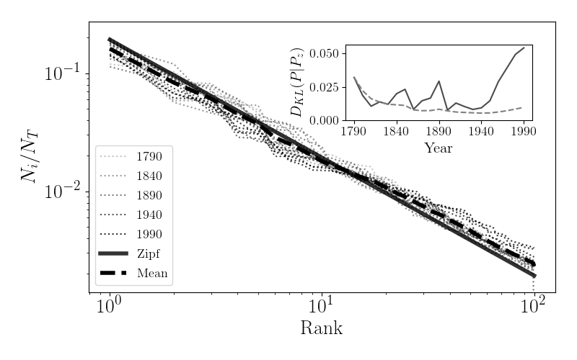
US Urban System Since 1790 (top 100 cities)
How close is it to Zipf’s law?
measured as information
$$D_{KL}(P(x)||P_{zipf}(x))=\underset{i}{∑}P(x_{i})log\frac{P(x_{i})}{P_{zipf}(x_{i})}$$
recall that $D_{KL}$ is a measure of distance between 2 distributions
https://www.nature.com/articles/s41467-020-18205-1
US City Size distribution has been deviating from Zipf’s law since 1940
People prefer to go to the West and Southwest, Texas
Notes:
Here is what the data looks like through most of the US history. We use the DKL to track the deviations of the real distribution from Zipf’s law… as you can see this distance has actually been increasing recently …

Slide 22
Summary
The “laws” of Geography are contained in Demography
in the dynamics of births, deaths and migration for cities
But they require special conditions
and time to emerge
Demographic “Equilibrium”
Or “neutrality”
Does not mean that cities do not grow/decay
They are NOT automatic or exact
…just means that they do that at the same rate
we do see how decision made by individuals
are interconnected and create an emergent structure for the urban system
Notes:
So, the laws of geography are very rough, averaged results. Most of them are specific demographic results under simplifying situations, which may apply better or worse to the real world. They are also very slow to emerge. In general it is interesting to have these results as reference points, but also to understand and measure deviations as choices, for example of cities that at some times are preferred…

